Slide 1
CS 2420: Introduction to Algorithms and Data Structures
Dr. Tsung-Wei (TW) Huang
Department of Electrical and Computer Engineering
University of Utah, Salt Lake City, UT
Notes:
Hi everyone, thanks for giving me this opportunity to present Taskflow. This is a project motivated by parallelizing CAD and has gained quite a lot of success. I am going to present Taskflow works and hopefully we can brainstorm some collaboration topics.
Taskflow is a general-purpose parallel and heterogeneous task computing system.

Slide 2
Why Algorithms and Data Structures?
It’s critical to advance your application performance
10x faster
100x faster
Notes:
You probably already know, parallel computing is critical to advance your application performance. For example, a single threaded machine learning program can take several hours to finish, but it can be reduced to only a few minutes or even a few seconds, if you are able to run it in parallel.
That’s the power of parallel computing. By leveraging manycore processing units, you are able to speed up the performance by several orders of magnitude.

Slide 3
Course Goal
In this course, we will look at:
Algorithms for solving problems efficiently
Data structures for efficiently storing, accessing, and modifying data
We will see that all data structures have trade-offs
There is no ultimate data structure...
The choice depends on our requirements

Slide 4
Class Logistics
Staff
Instructor: T-W Huang (tsung-wei.huang@utah.edu)
TA: I will help you directly
Class schedule: 9 AM –10:20 AM Mon/Wed
Class zoom: https://utah.zoom.us/j/2468214418
Class GitHub: https://github.com/tsung-wei-huang/cs2420
Lab
We will do the lab after each Wed class, since we have <10 students
No need to zoom in on Friday
You still need to enroll in the lab section (class number: 19145)

Slide 5
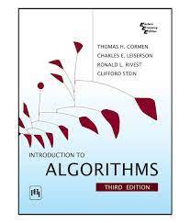
Scoring and Textbook
Lab assignment (after every Wed’s class): 60%
Take-home exams: 40%
Two midterms
One final
Textbook: Introduction to Algorithms
3rd Edition (The MIT Press)
This is the “bible” of algorithm book

Slide 6
Example: Power of Data Structure
Consider searching an element in an array
What is the index of 6?
What is the index of 17?
What is the index of 96?
7 | 11 | 6 | 55 | 98 | 45 | 16 | 96 | 46

Slide 7
Example: Power of Data Structure (cont’d)
Consider searching an element in a sorted array
What is the index of 6?
What is the index of 17?
What is the index of 96?
7 | 11 | 6 | 55 | 98 | 45 | 16 | 96 | 46
6 | 7 | 11 | 16 | 45 | 46 | 55 | 96 | 98

Slide 8


Slide 9
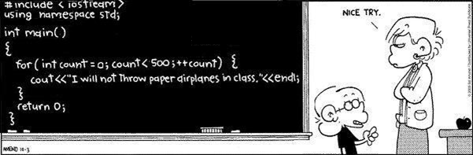
Programming Language: C++
Online C++ editor: https://www.onlinegdb.com/

Slide 10
Data Structure = Memory Manipulation
Memory allocation can be classified as either
Contiguous
Linked
Indexed
Prototypical examples:
Contiguous allocation: arrays
Linked allocation: linked lists

Slide 11
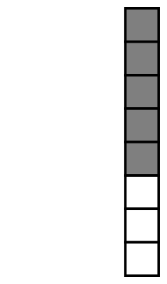
Contiguous Memory Allocation
An array stores n objects in a single contiguous space of memory
Unfortunately, if more memory is required, a request for new memory usually requires copying all information into the new memory
In general, you cannot request for the operating system to allocate to you the next n memory locations

Slide 12

Linked Allocation
Linked storage such as a linked list associates two pieces of data with each item being stored:
The object itself, and
A reference to the next item
In C++ that reference is the address of the next node

Slide 13
Linked Allocation (cont’d)
This is a class describing such a node
template <typename Type>
class Node {
private:
Type node_value;
Node *next_node;
public:
// ...
};

Slide 14
Linked Allocation (cont’d)
The operations on this node must include:
Constructing a new node
Accessing (retrieving) the value
Accessing the next pointer
Node( const Type& = Type(), Node* = nullptr );
Type value() const;
Node *next() const;
Pointing to nothing has been represented as:
C NULL
Java/C# null
C++ (old) 0
C++ (new) nullptr
Symbolically Ø

Slide 15
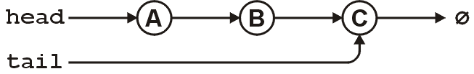
Linked Allocation (cont’d)
For a linked list, however, we also require an object which links to the first object
The actual linked list class must store two pointers
A head and tail:
Node *head;
Node *tail;
Optionally, we can also keep a count
int count;
The next_node of the last node is assigned nullptr

Slide 16
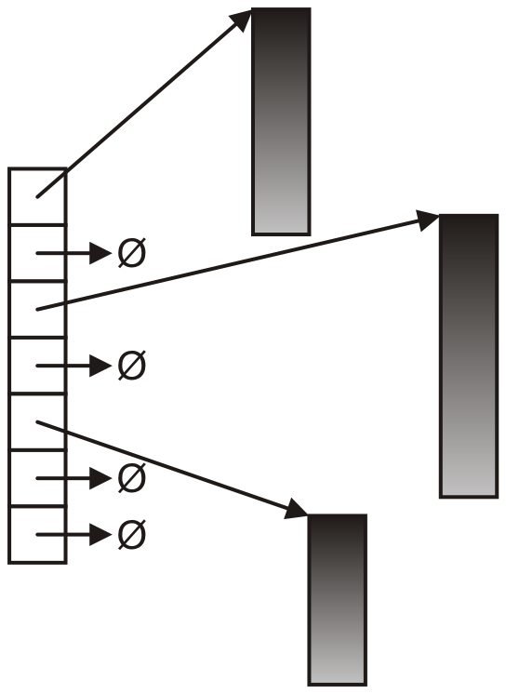
Indexed Allocation
With indexed allocation, an array of pointers (possibly NULL) link to a sequence of allocated memory locations
Used in the C++ standard template library
Computer engineering students will see indexed allocation in their operating systems course

Slide 17
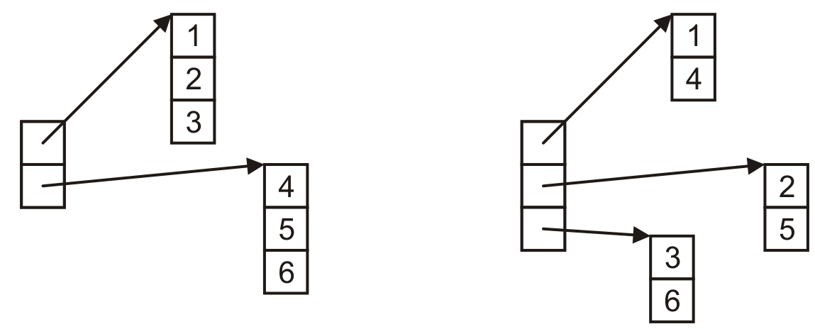
Indexed Allocation (cont’d)
Matrix can be implemented using indexed allocation

Slide 18
Other Allocation Formats
We will look at some variations or hybrids of these memory allocations including:
Trees
Graphs
Deques (linked arrays)
inodes

Slide 19
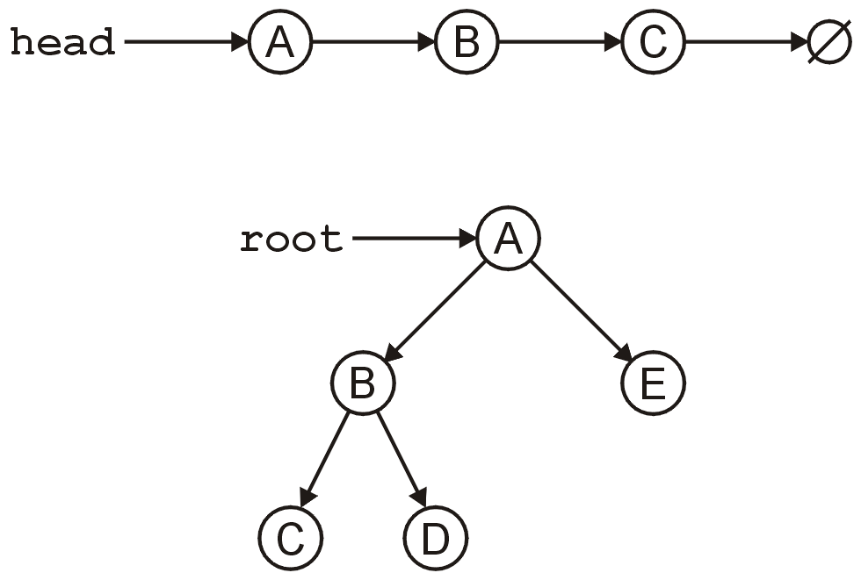
Tree
A tree is a variation on a linked list:
Each node points to an arbitrary number of subsequent nodes
Useful for storing hierarchical data
We will see that it is also useful for storing sorted data
Usually we will restrict ourselves to trees where each node points to at most two other nodes

Slide 20
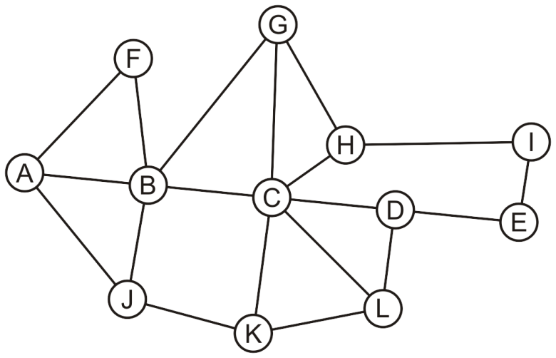
Graph
Suppose we allow arbitrary relations between any two objects in a container
Given n objects, there are n² – n possible relations
If we allow symmetry, this reduces to
For example, consider the network

Slide 21
Graph in Adjacency Matrix
Suppose we allow arbitrary relations between any two objects in a container
We could represent this using a two-dimensional array
In this case, the matrix is symmetric
 | A | B | C | D | E | F | G | H | I | J | K | L
A |  | × |  |  |  | × |  |  |  | ×
B | × |  | × |  |  | × | × |  |  | ×
C |  | × |  | × |  |  | × | × |  |  | × | ×
D |  |  | × |  | × |  |  |  |  |  |  | ×
E |  |  |  | × |  |  |  |  | ×
F | × | ×
G |  | × | × |  |  |  |  | ×
H |  |  | × |  |  |  | × |  | ×
I |  |  |  |  | × |  |  | ×
J | × | × |  |  |  |  |  |  |  |  | ×
K |  |  | × |  |  |  |  |  |  | × |  | ×
L |  |  | × | × |  |  |  |  |  |  | ×

Slide 22
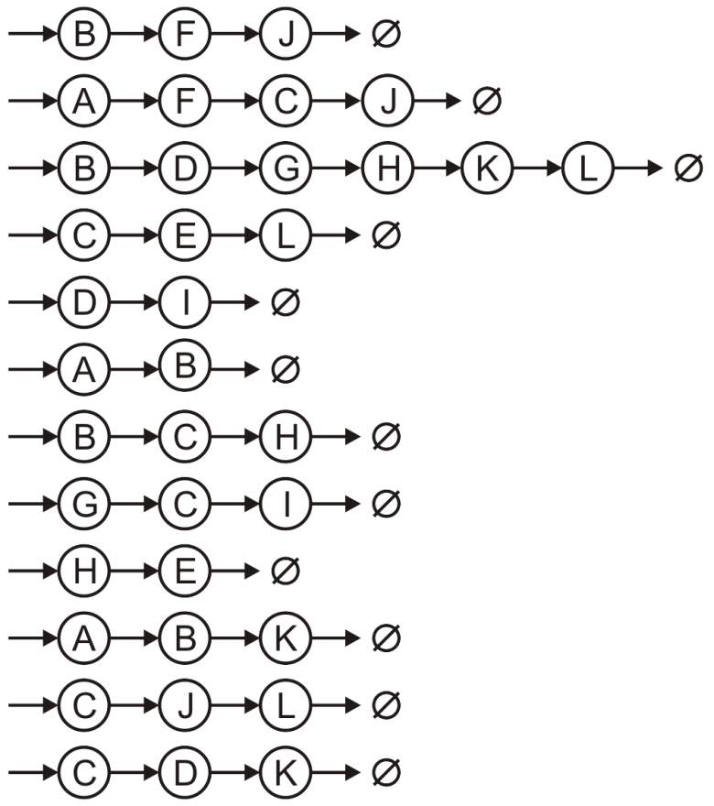
Graph in Adjacency List
Suppose we allow arbitrary relations between any two objects in a container
Alternatively, we could use a hybrid: an array of linked lists
A
B
C
D
E
F
G
H
I
J
K
L

Slide 23
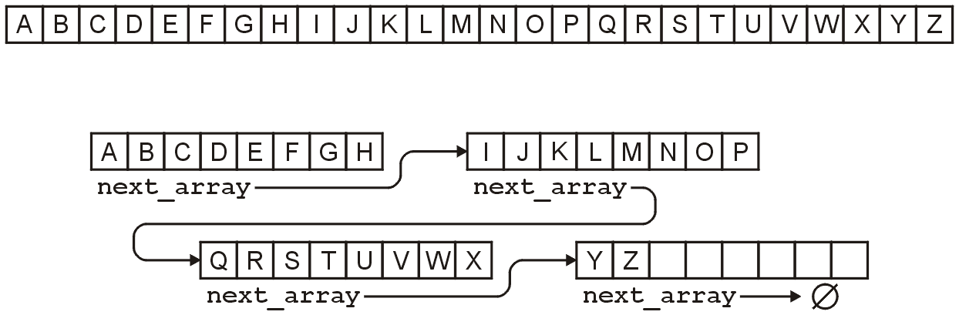
Linked Arrays
Other hybrids are linked lists of arrays
Something like this is used for the C++ STL deque container
For example, the alphabet could be stored either as:
An array of 26 entries, or
A linked list of arrays of 8 entries

Slide 24
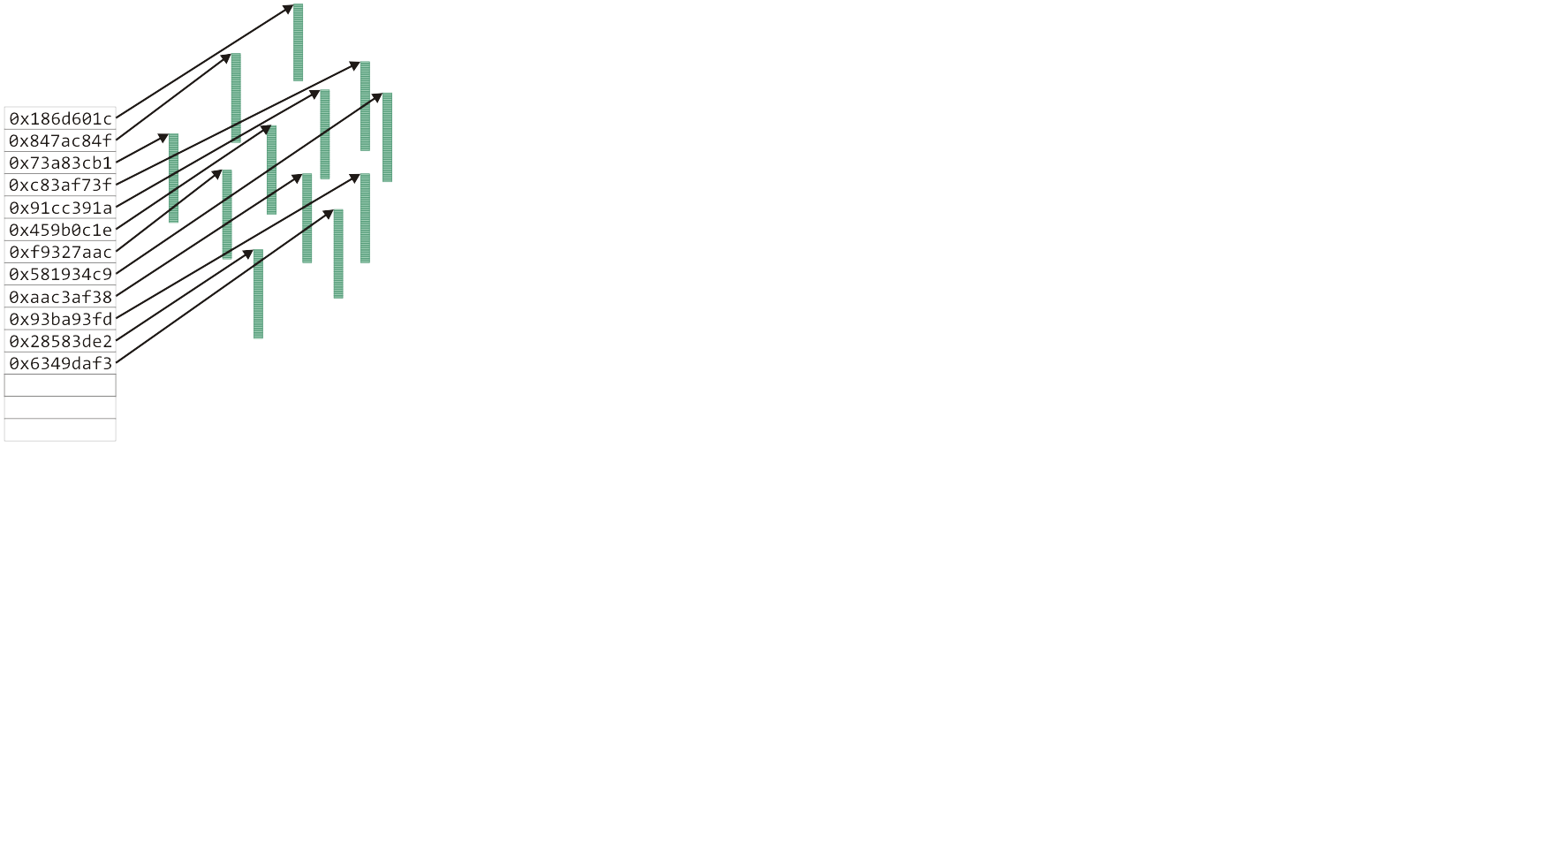
Hyper Data Structure
The Unix inode was used to store information about large files
The first twelve entries can reference the first twelve blocks (48 KiB)

Slide 25
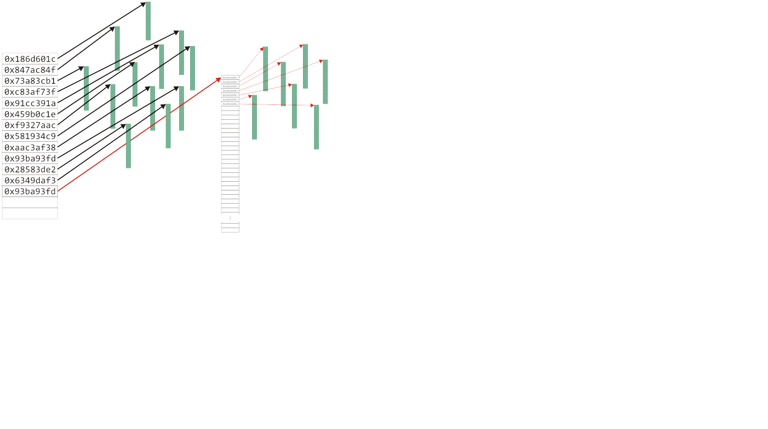
Hyper Data Structure (cont’d)
The Unix inode was used to store information about large files
The first twelve entries can reference the first twelve blocks (48 KiB)

Slide 26
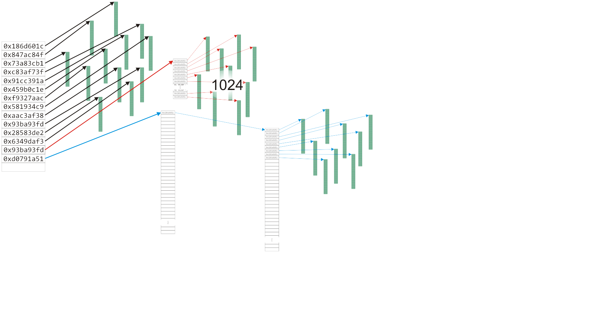
Hyper Data Structure (cont’d)
The Unix inode was used to store information about large files
The first twelve entries can reference the first twelve blocks (48 KiB)

Slide 27
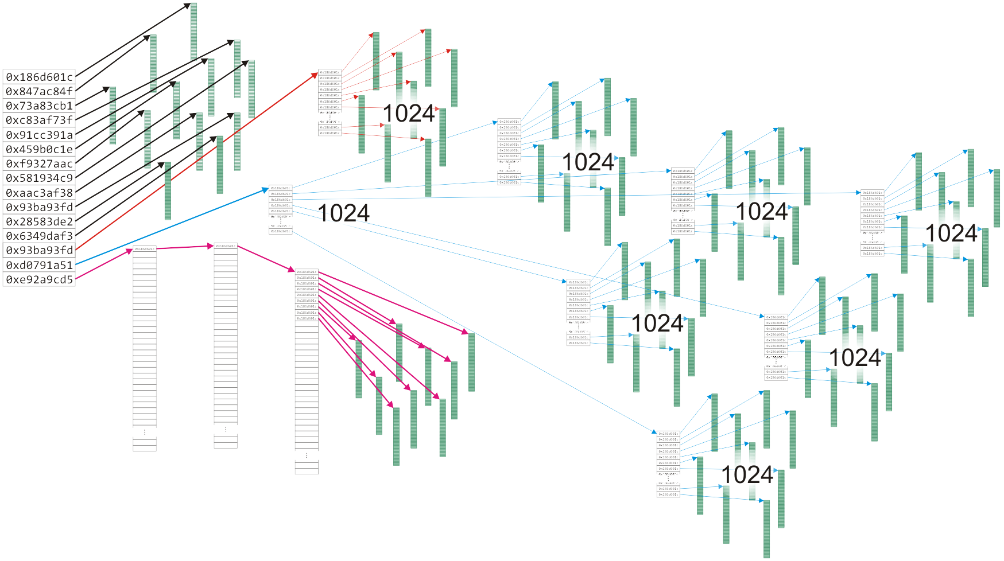
Hyper Data Structure (cont’d)
The Unix inode was used to store information about large files
The first twelve entries can reference the first twelve blocks (48 KiB)

Slide 28
Algorithms Run Times
Once we have chosen a data structure to store both the objects and the relationships, we must implement the queries or operations as algorithms
The Abstract Data Type will be implemented as a class
The data structure will be defined by the member variables
The member functions will implement the algorithms
The question is, how do we determine the efficiency of the algorithms?

Slide 29
Operation Efficiency Table
We will us the following matrix to describe operations at the locations within the structure
 | Front/1st | Arbitrary Location | Back/n^{th}
Find | ? | ? | ?
Insert | ? | ? | ?
Erase | ? | ? | ?

Slide 30
Operations on Sorted Lists
Given an sorted array, we have the following run times:
 | Front/1st | Arbitrary Location | Back/n^{th}
Find | Good | Okay | Good
Insert | Bad | Bad | Good* | Bad
Erase | Bad | Bad | Good
* only if the array is not full

Slide 31
Operations on Lists
 | Front/1st | Arbitrary Location | Back/n^{th}
Find | Good | Bad | Good
Insert | Bad | Bad | Good* | Bad
Erase | Bad | Bad | Good
* only if the array is not full
If the array is not sorted, only one operations changes:
Notes:
31

Slide 32
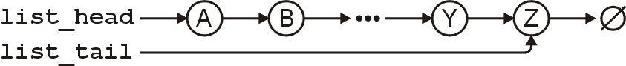
Operations on Lists
However, for a singly linked list where we a head and tail pointer, we have:
 | Front/1st | Arbitrary Location | Back/n^{th}
Find | Good | Bad | Good
Insert | Good | Bad | Good
Erase | Good | Bad | Bad

Slide 33
Operations on Lists
If we have a pointer to the k^{th} entry, we can insert or erase at that location quite easily
Note, this requires a little bit of trickery: we must modify the value stored in the k^{th} node
This is a common co-op interview question!
 | Front/1st | Arbitrary Location | Back/n^{th}
Find | Good | Bad | Good
Insert | Good | Good | Good
Erase | Good | Good | Bad

Slide 34
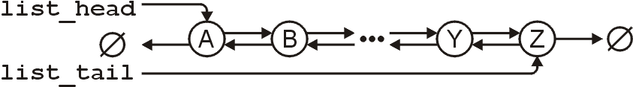
Operations on Lists
For a doubly linked list, one operation becomes more efficient:
 | Front/1st | Arbitrary Location | Back/n^{th}
Find | Good | Bad | Good
Insert | Good | Good | Good
Erase | Good | Good | Good

Slide 35
Summary
In this topic, we have introduced the concept of data structures
We discussed contiguous, linked, and indexed allocation
We looked at arrays and linked lists
We considered
Trees
Two-dimensional arrays
Hybrid data structures
We considered the run time of the algorithms required to perform various queries and operations on specific data structures:
Arrays and linked lists
The next topic, asymptotic analysis, will provide the mathematics that will allow us to measure the efficiency of algorithms
Notes:
To sum up, we have presented taskflow as a general-purpose parallel tasking tool. It introduces a simple, efficient, and transparent tasking model for C++ developers to quickly write parallel programs using minimal programming effort. We also talked about the general idea about our heterogeneous work-stealing executor and demonstrated its promising performance in large-scale ML and VLSI CAD workloads.
There are many excellent efforts from the C++ community on parallelism. Taskflow is not to replace anyone but to complement the current state of the art and address their limitations on the task graph parallelism by leveraging the power of modern C++.
We are very open to collaboration. We believe collaborative effort is the only way to make C++ amenable to parallel computing. Right now, we are based on cuda for GPU tasking, but we definitely want to integrate OpenCL, SYCL, DPC++, and so on. We want to provide more higher level algorithms on top of our task graph, like the thrust library, so developers can easily describe common parallel applications.
If you ever used Taskflow, please let us know, and we want to learn from you and broaden real use cases.

Slide 36


Use the right tool for the right job
Dr. Tsung-Wei Huang
tsung-wei.huang@utah.edu

